Slide 1

ECMS Data Annotator
Prepared by
Zheyang Cao
Binbin Ni
Penglin Jin
Zixin Jiang
Prepared for
Mr. Parma Nand
Mr. Petteri Kaskenpalo
Supervisor
Mr. Lingmin He

Slide 2

Objectives
Build an annotate tool which can upload and annotate the dataset by different user-defined label

Slide 3
Requirement Analysis
Database Design & Construction
Project Status
UI ——Prototype & Implement
The realization of functional modules

Slide 4
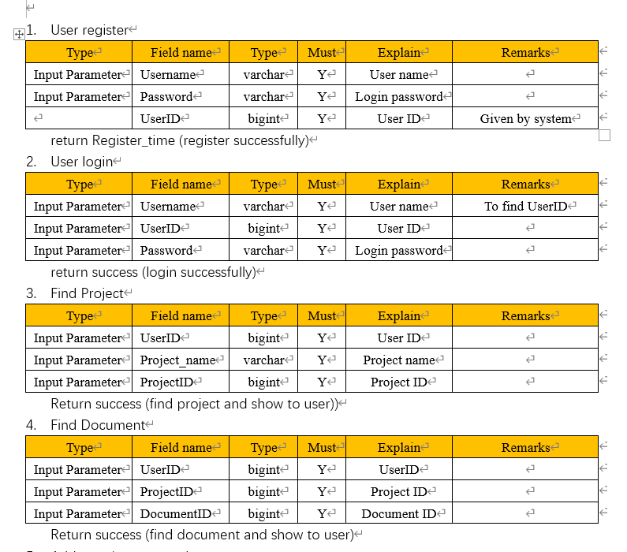
Requirement Analysis

Slide 5
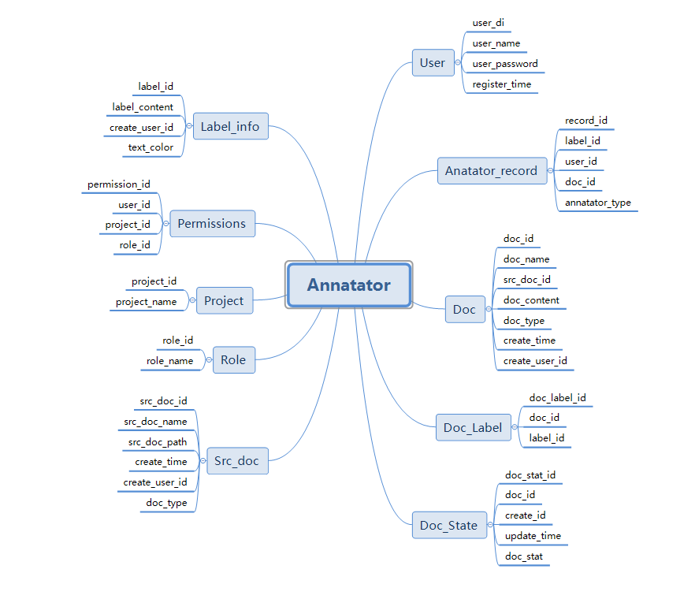
Database Design & Construction

Slide 6

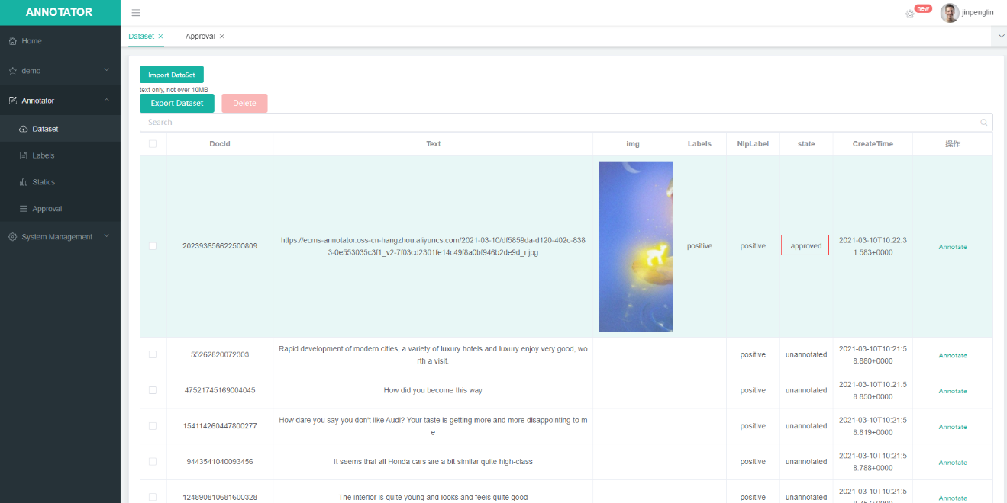
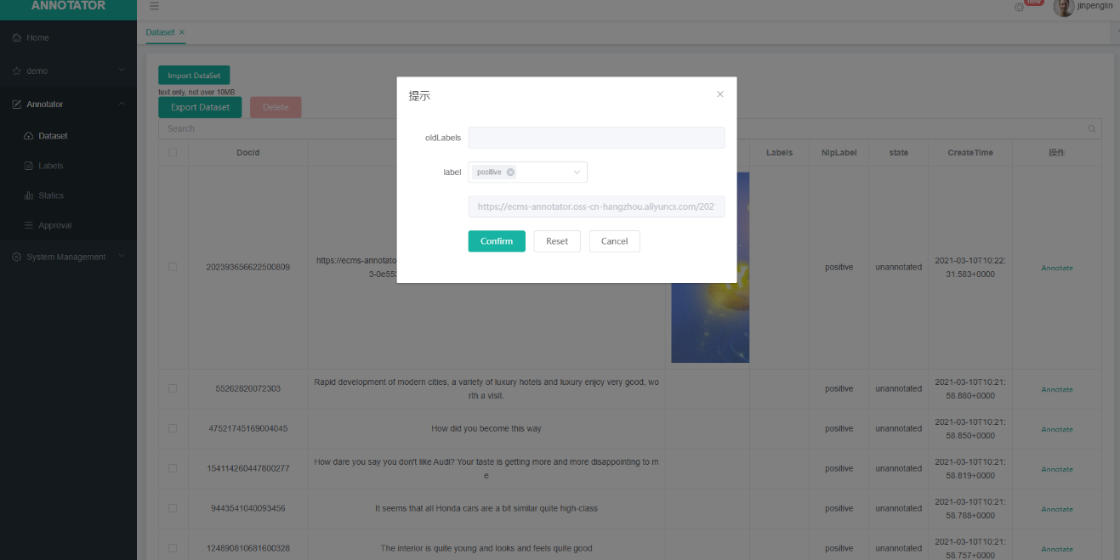
UI —Prototype
& Implement

Slide 7
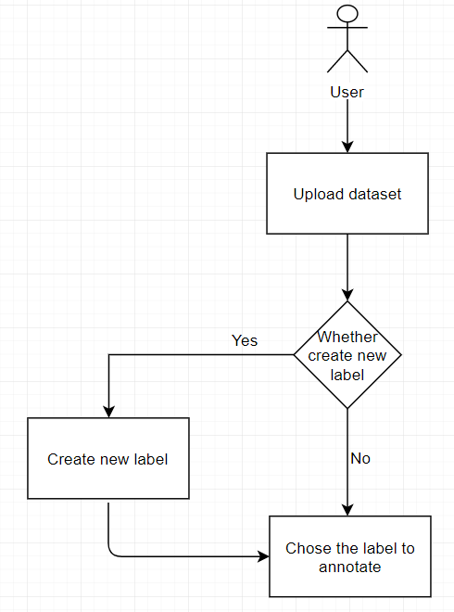

Dataset Upload and Annotate
Text and Pictures

Slide 8
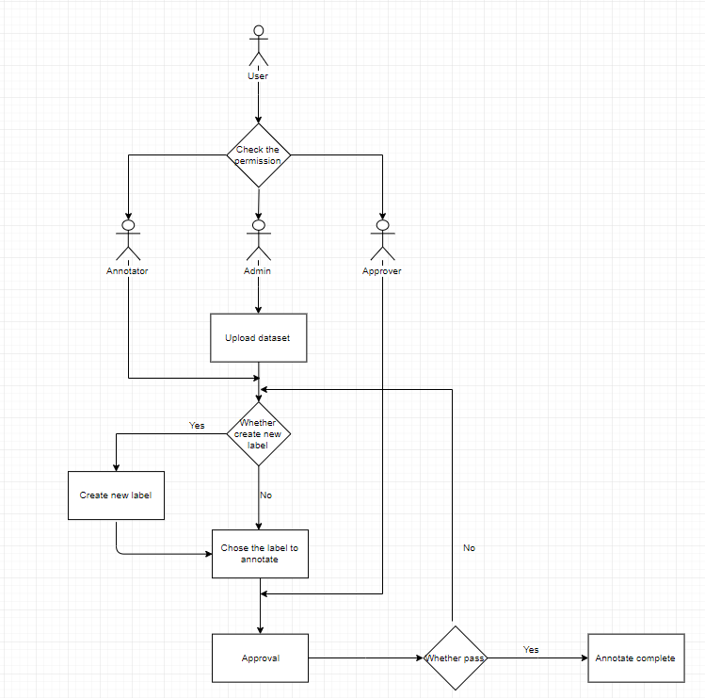
Multi-person collaborative
Annotation

Slide 9
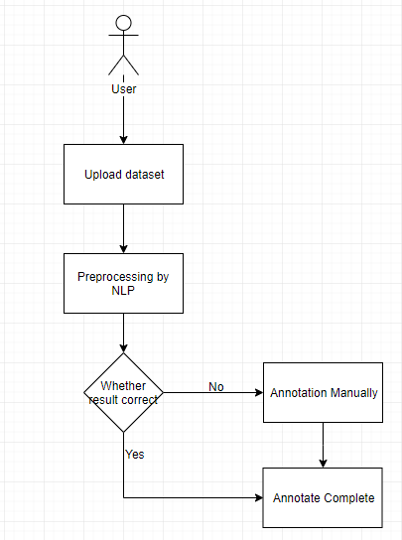
NLP preprocessing

Slide 10
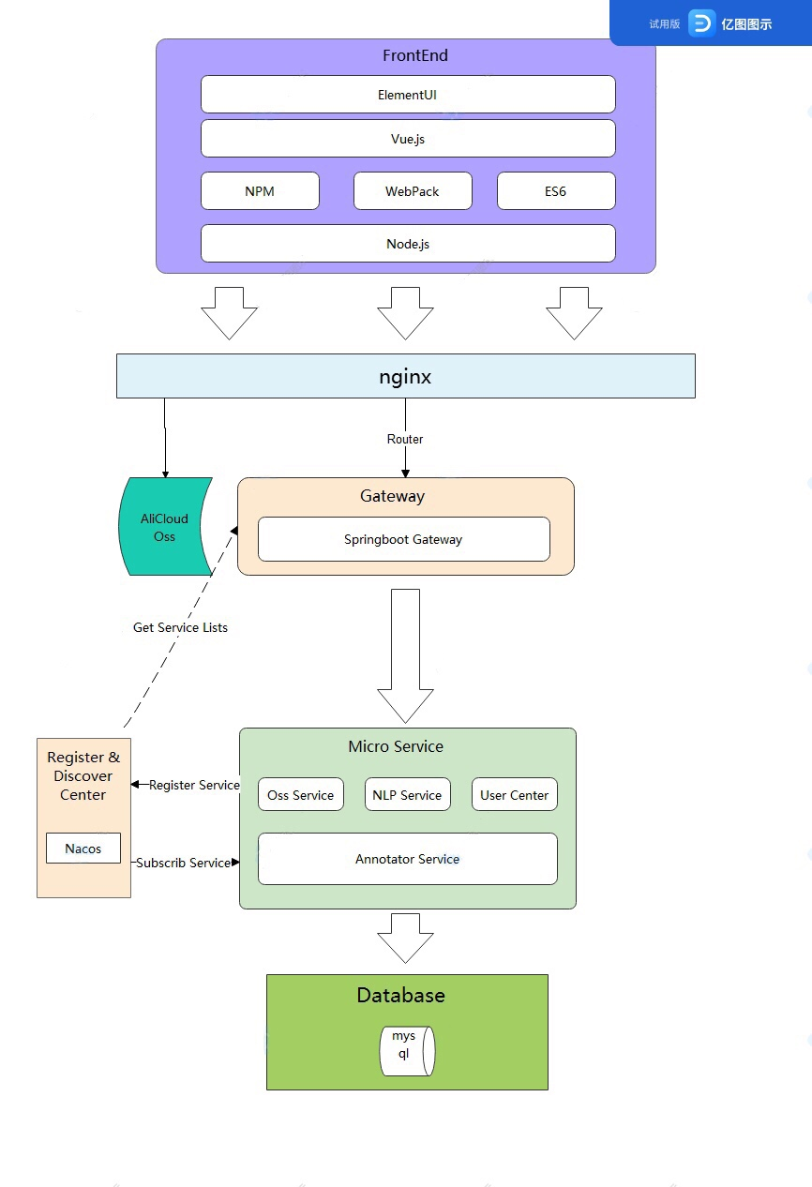
System Architecture

Slide 11
Demo Display

Slide 12
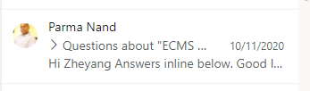
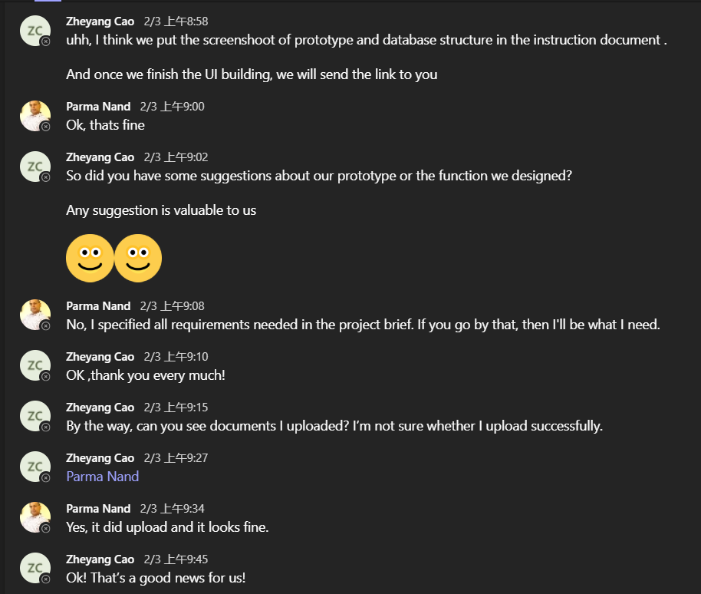
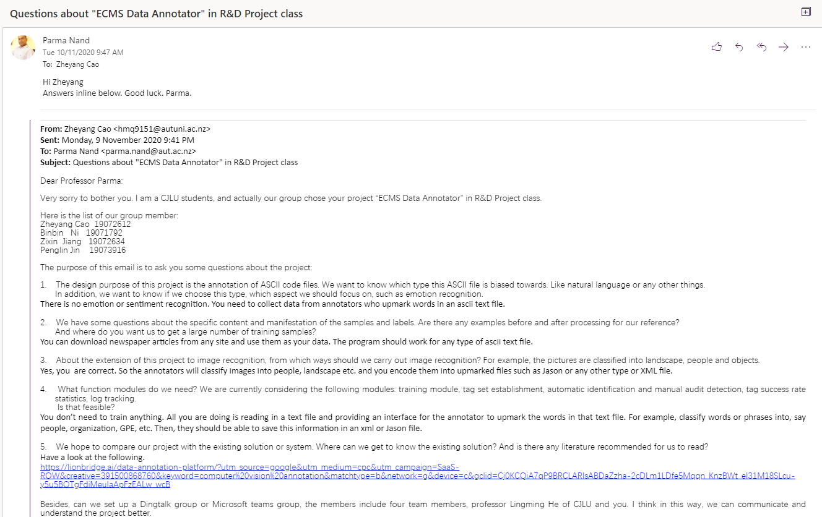
Organized Process– with client

Slide 13
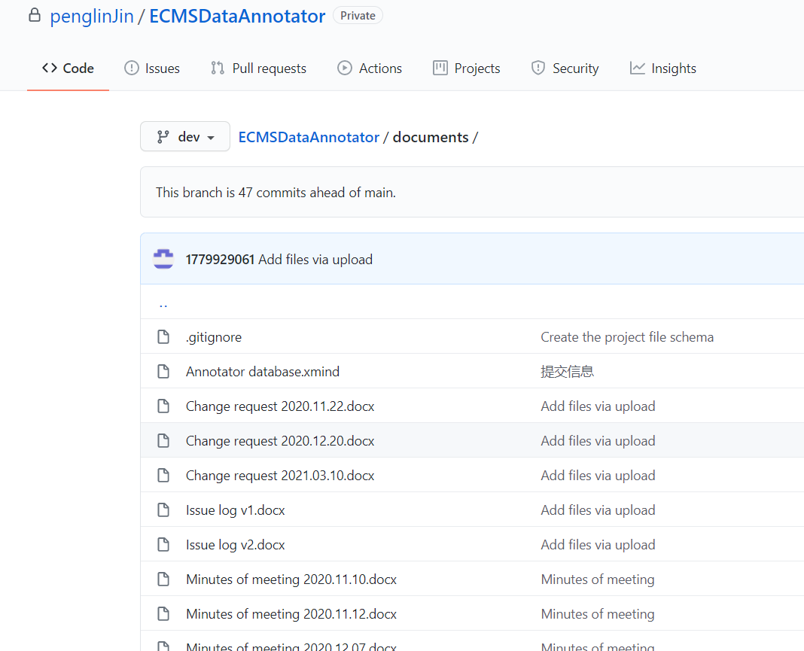
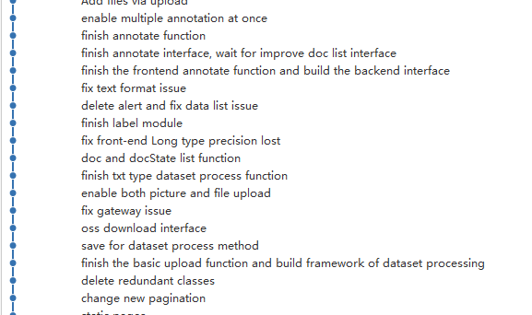
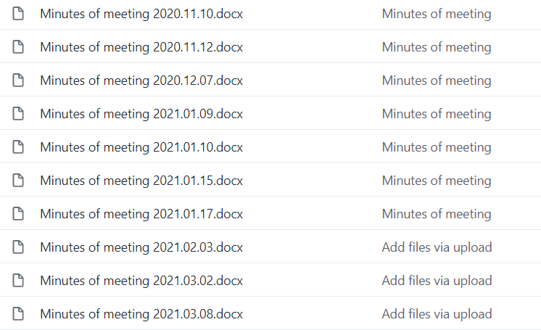
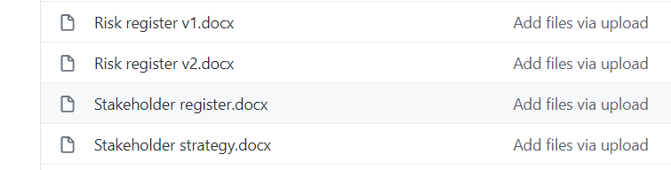
Organized Process – in team
Hold regular meetings and take minutes
Code updates are uploaded to GitHub in real time
Sound project management process and record

Slide 14
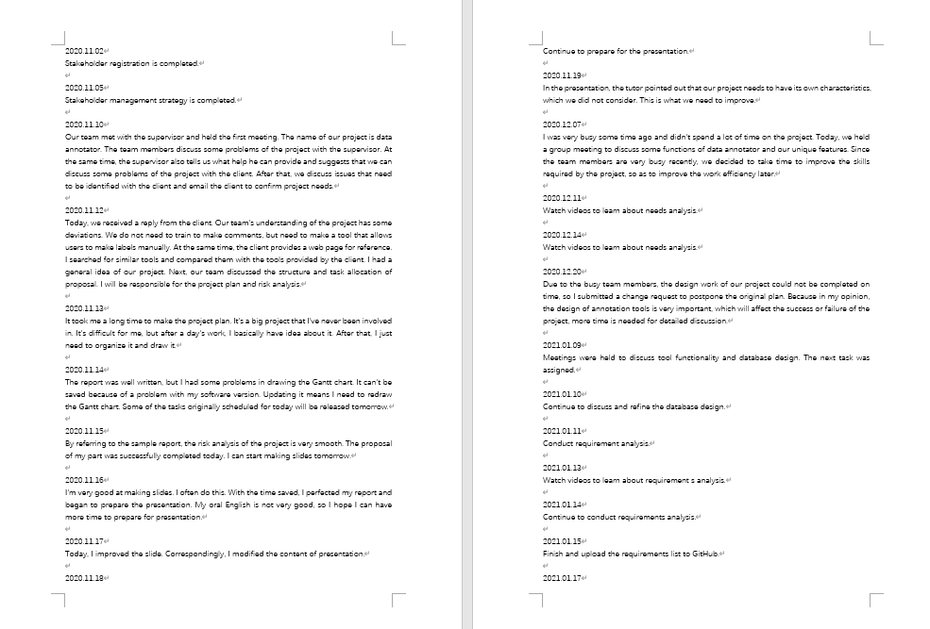
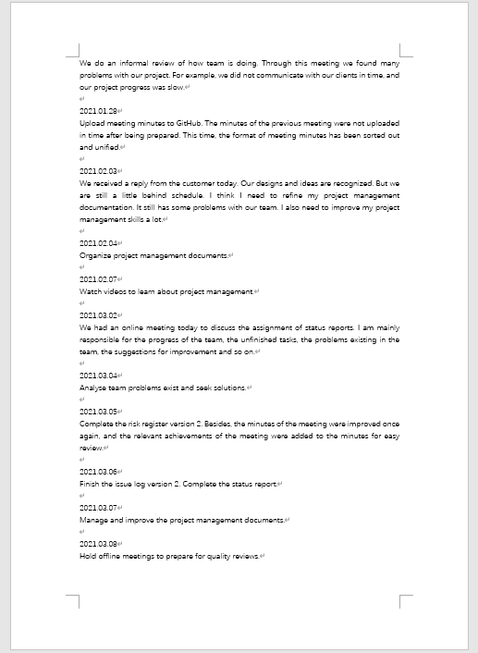
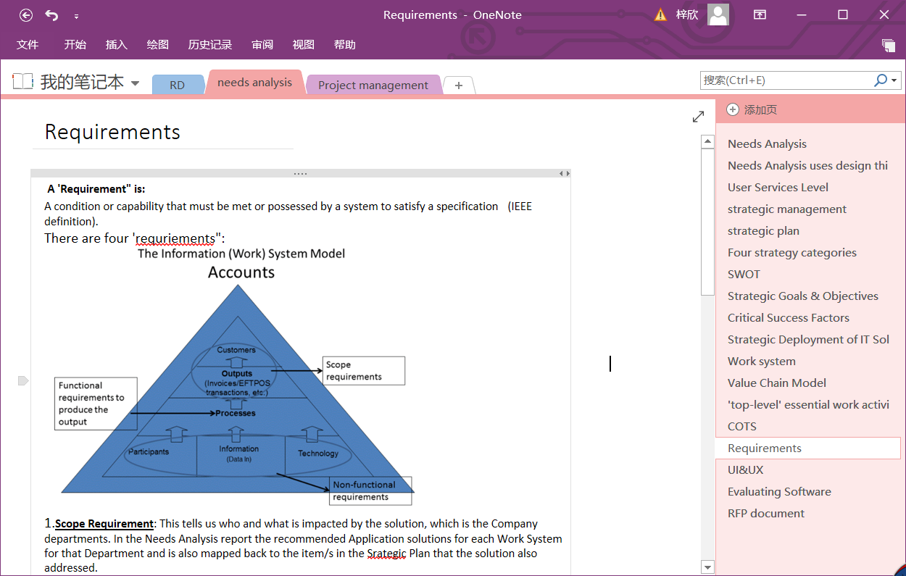
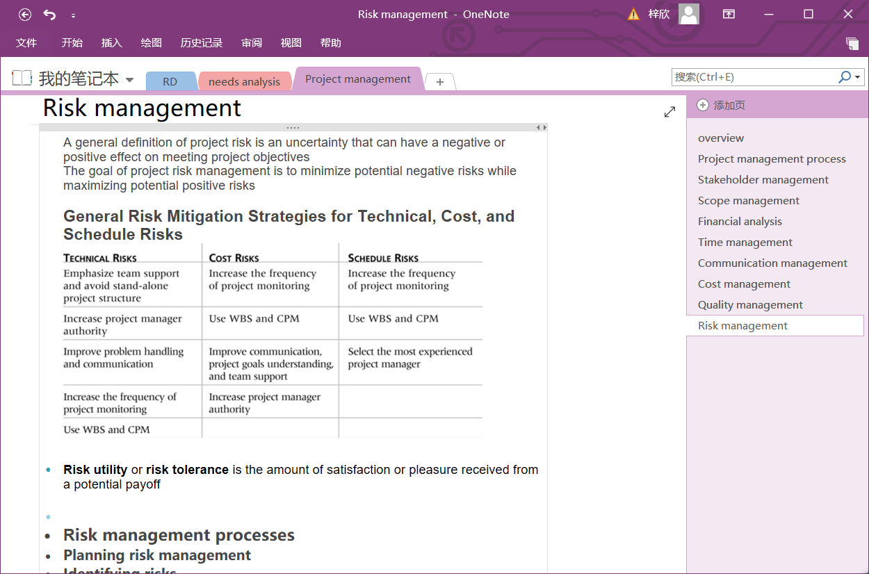
Learning Progress – Jiang Zixin

Slide 15
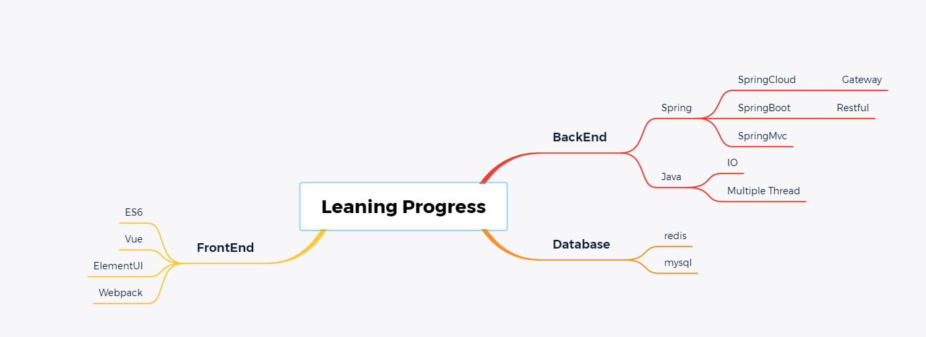
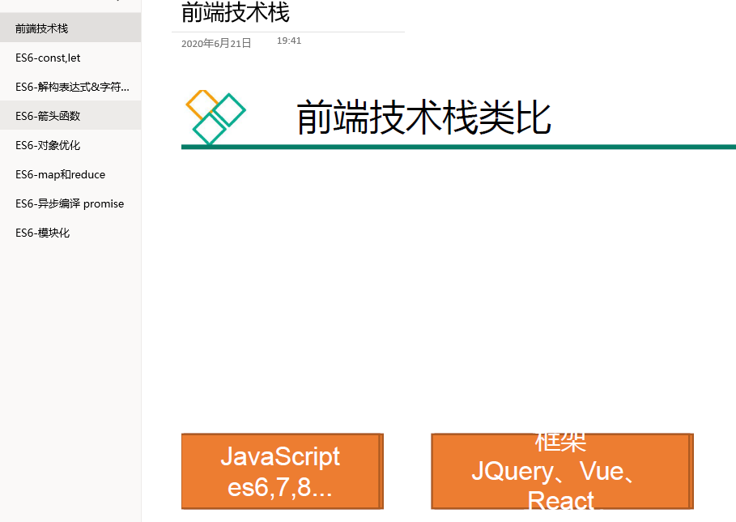
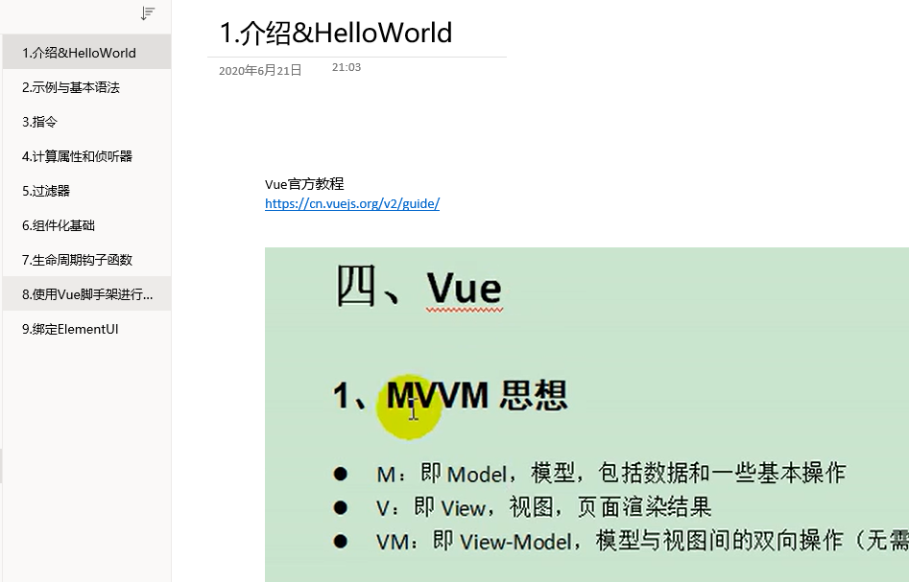
Learning Progress
– Jin Penglin

Slide 16
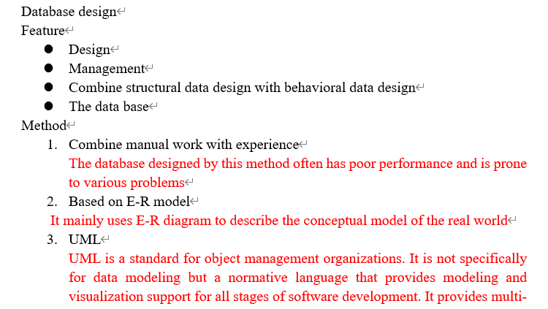
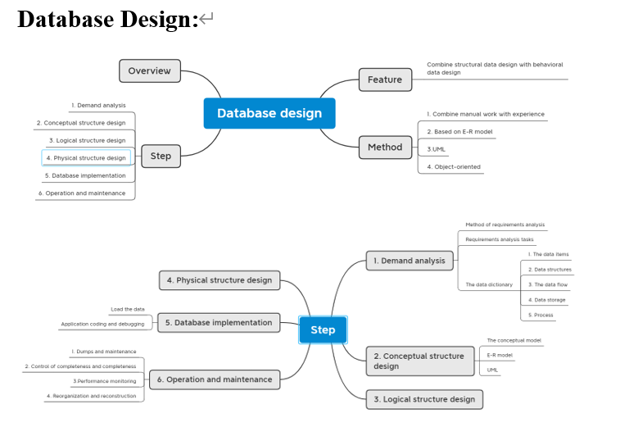
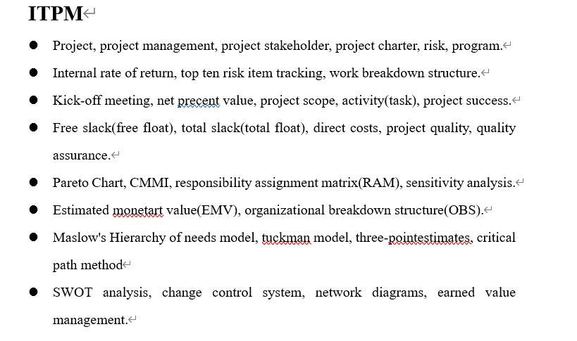
Learning Progress – Cao Zheyang

Slide 17
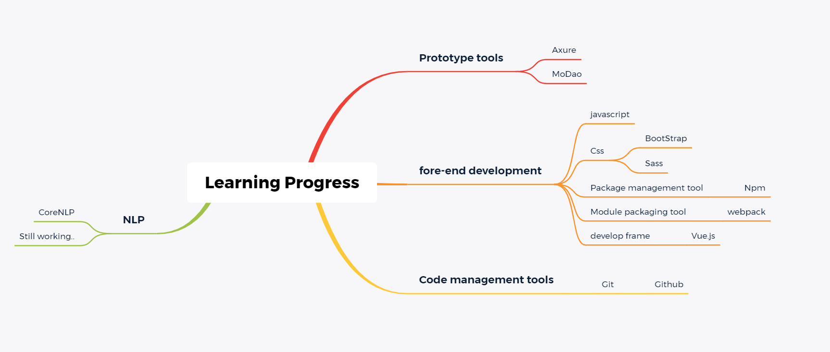
Learning Progress -- Nibinbin

Slide 18
Project Completion Plan
Item | Description | Planned completion time
Front-end interface | Although the front-end interface has been designed, the page production has not been completed and also need to be optimized. | 2021.03.25
Improve the NLP preprocessing | Improve the accuracy of preprocessing the imported dataset by NLP. | 2021.04.23
Improve the stability | Considering the situation that the tool will face after it is put into use, the stability of the tool currently produced by the team still needs to be improved. | 2021.04.27

Slide 19
Thanks

